Slide 1
Recursion

Slide 2




Ex. 1: The Handshake Problem
There are n people in a room. If each person shakes hands once with every other person. What is the total number h(n) of handshakes?
h(n) = h(n-1) + n-1
h(4) = h(3) + 3
h(3) = h(2) + 2
h(2) = 1
h(n): Sum of integer from 1 to n-1 = n(n-1) / 2

Slide 3
Recursion
In some problems, it may be natural to define the problem in terms of the problem itself.
Recursion is useful for problems that can be represented by a simpler version of the same problem.
Example: the factorial function
6! = 6 * 5 * 4 * 3 * 2 * 1
We could write:
6! = 6 * 5!

Slide 4
Example 2: factorial function
In general, we can express the factorial function as follows:
n! = n * (n-1)!
Is this correct? Well… almost.
The factorial function is only defined for positive integers. So we should be a bit more precise:
n! = 1 (if n is equal to 1)
n! = n * (n-1)! (if n is larger than 1)

Slide 5
factorial function
The C++ equivalent of this definition:
int fac(int numb){
if(numb<=1)
return 1;
else
return numb * fac(numb-1);
}
recursion means that a function calls itself

Slide 6
factorial function
Assume the number typed is 3, that is, numb=3.
fac(3) :
  3 <= 1 ? No.
  fac(3) = 3 * fac(2)
  fac(2) :
    2 <= 1 ? No.
    fac(2) = 2 * fac(1)
    fac(1) :
      1 <= 1 ? Yes.
      return 1
int fac(int numb){
if(numb<=1)
return 1;
else
return numb * fac(numb-1);
}
    fac(2) = 2 * 1 = 2
    return fac(2)
  fac(3) = 3 * 2 = 6
  return fac(3)
fac(3) has the value 6

Slide 7
factorial function
For certain problems (such as the factorial function), a recursive solution often leads to short and elegant code. Compare the recursive solution with the iterative solution:
Iterative solution
int fac(int numb){
int product=1;
while(numb>1){
product *= numb;
numb--;
}
return product;
}
Recursive solution
int fac(int numb){
if(numb<=1)
return 1;
else
return numb*fac(numb-1);
}

Slide 8
Recursion
If we use iteration, we must be careful not to create an infinite loop by accident:
for(int incr=1; incr!=10;incr+=2)
...
int result = 1;
while(result >0){
...
result++;
}
Oops!
Oops!

Slide 9
Recursion
Similarly, if we use recursion we must be careful not to create an infinite chain of function calls:
int fac(int numb){
return numb * fac(numb-1);
}
Or:
int fac(int numb){
if (numb<=1)
return 1;
else
return numb * fac(numb+1);
}
Oops!
No termination condition
Oops!

Slide 10
Recursion
We must always make sure that the recursion bottoms out:
A recursive function must contain at least one non-recursive branch.
The recursive calls must eventually lead to a non-recursive branch.

Slide 11
Recursion
Recursion is one way to decompose a task into smaller subtasks. At least one of the subtasks is a smaller example of the same task.
The smallest example of the same task has a non-recursive solution.
  Example: The factorial function
  n! = n * (n-1)! and 1! = 1

Slide 12
Direct Computation Method
Fibonacci numbers:
  0, 1, 1, 2, 3, 5, 8, 13, 21, 34, ...
where each number is the sum of the preceding two.
Recursive definition:
  F(0) = 0;
  F(1) = 1;
  F(number) = F(number-1)+ F(number-2);

Slide 13
Example 3: Fibonacci numbers
//Calculate Fibonacci numbers using recursive function.
//A very inefficient way, but illustrates recursion well
int fib(int number)
{
if (number == 0) return 0;
if (number == 1) return 1;
return (fib(number-1) + fib(number-2));
}
int main(){ // driver function
int inp_number;
cout << "Please enter an integer: ";
cin >> inp_number;
cout << "The Fibonacci number for "<< inp_number
<< " is "<< fib(inp_number)<<endl;
return 0;
}

Slide 14
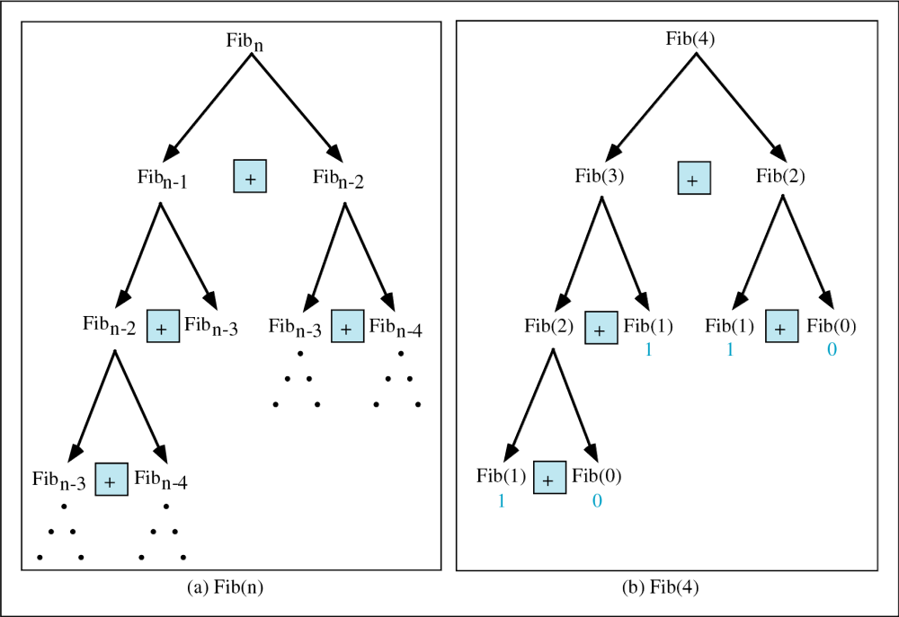
Copyright © 2000 by Brooks/Cole Publishing Company
A division of International Thomson Publishing Inc.

Slide 15
Trace a Fibonacci Number
int fib(int num)
{
if (num == 0) return 0;
if (num == 1) return 1;
return
(fib(num-1)+fib(num-2));
}
Assume the input number is 4, that is, num=4:
fib(4):
  4 == 0 ? No; 4 == 1? No.
  fib(4) = fib(3) + fib(2)
  fib(3):
    3 == 0 ? No; 3 == 1? No.
    fib(3) = fib(2) + fib(1)
    fib(2):
      2 == 0? No; 2==1? No.
      fib(2) = fib(1)+fib(0)
    fib(1):
    1== 0 ? No; 1 == 1? Yes.
    fib(1) = 1;
    return fib(1);

Slide 16
Trace a Fibonacci Number
fib(0):
    0 == 0 ? Yes.
    fib(0) = 0;
    return fib(0);
    fib(2) = 1 + 0 = 1;
    return fib(2);
  fib(3) = 1 + fib(1)
fib(1):
    1 == 0 ? No; 1 == 1? Yes
    fib(1) = 1;
    return fib(1);
  fib(3) = 1 + 1 = 2;
  return fib(3)

Slide 17
Trace a Fibonacci Number
fib(2):
      2 == 0 ? No; 2 == 1? No.
      fib(2) = fib(1) + fib(0)
      fib(1):
    1== 0 ? No; 1 == 1? Yes.
    fib(1) = 1;
    return fib(1);
    fib(0):
    0 == 0 ? Yes.
    fib(0) = 0;
    return fib(0);
    fib(2) = 1 + 0 = 1;
    return fib(2);
  fib(4) = fib(3) + fib(2)
  = 2 + 1 = 3;
  return fib(4);

Slide 18
Example 4: Fibonacci number w/o recursion
//Calculate Fibonacci numbers iteratively
//much more efficient than recursive solution
int fib(int n)
{
int f[100];
f[0] = 0; f[1] = 1;
for (int i=2; i<= n; i++)
f[i] = f[i-1] + f[i-2];
return f[n];
}

Slide 19
Recursion General Form
How to write recursively?
int recur_fn(parameters){
if(stopping condition)
return stopping value;
// other stopping conditions if needed
return function of recur_fn(revised parameters)
}

